Slide 1
WELCOME!
Adding Organized Reasoning to the IA Process
Lessons Learned So Far

Slide 2
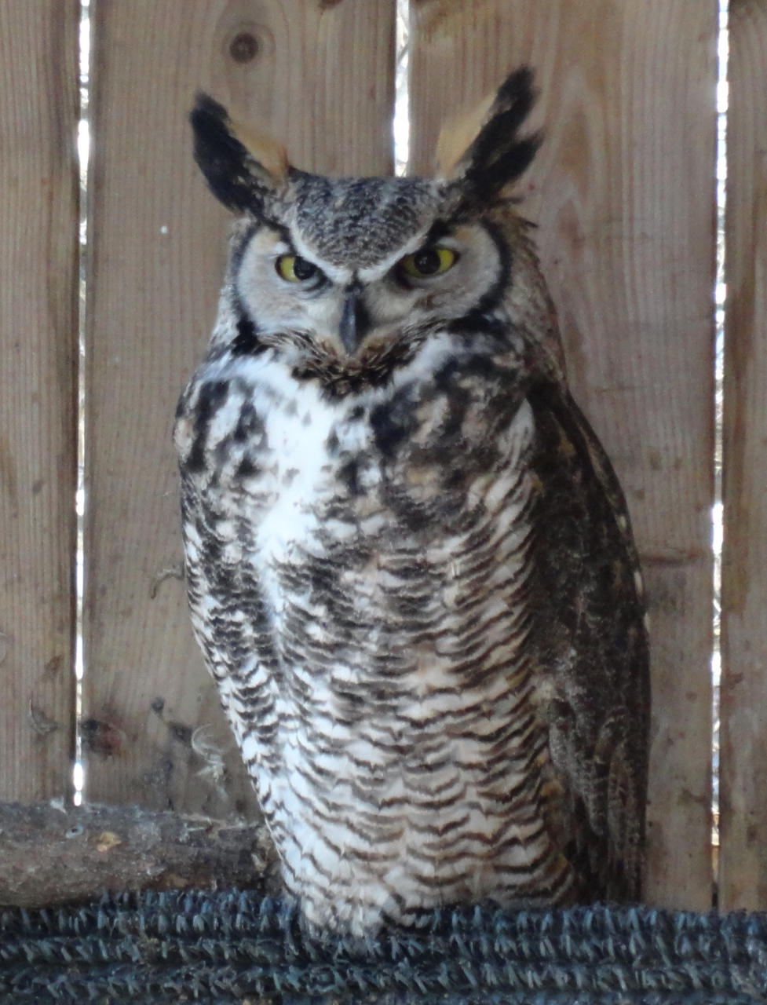
Using Organized Reasoning to Improve Environmental Assessment An Introduction
IAIA 2017
Montreal
Glenn Brown
glenn.brown@telus.net

Slide 3
What the OR Workshop is About
Organized Reasoning is a synthesis of ideas from various places
At first a university course for master’s students, key ideas have been condensed to a workshop targeted for IA practitioners

Slide 4
What is an Argument?
An argument involves:
A set of reasons
Leading to a conclusion
Intended for a particular audience
Offering Reasons leading to a Conclusion for an Audience
The argument must be
presented to

Slide 5
Goals
At base: clarity and completeness of thinking and communication
Target: fair, careful, thoughtful presentation of reasoning to bring audience to agreement (or at least understanding)
Practically: faster and cheaper (internally), more effective and transparent (externally) and reduce risk for all

Slide 6
So, Where Now? A Big Picture of Professional Tools
Organized Reasoning
Create your Argument
Structured Presentation
Package your Argument for your Audience

Slide 7
A Focus on Structure
Logical Structure
the way reasons support conclusions
e.g. R1 + R2 → C.
Creating the logical structure of arguments is ‘Organized Reasoning’
Presentation Structure
the way reasons and conclusions are presented to the audience

Slide 8
Foundations of Organized Reasoning
Basic Features of Argument
Words & Meaning
Hierarchy, Evidence and Complex Arguments
Analyzing Arguments
Strong Arguments
Argument Types
Fact, Evaluation, Recommendation

Slide 9
Structured Presentation: Three Toolsets
Strategic & Tactical Choices
Microstructure
(Within short text)
Macrostructure
(Within longer text)

Slide 10
Integration of Thinking and Writing
Steps of thinking
Process of research & creation that builds the argument & its presentation
Steps of composition

Slide 11
Break Out: Are there common argument types in IA phases?
Project Phase or Step | Common Kind(s) of Argument?
Project Description
Screening
Scoping
Pick VCs
Baseline Description / Studies
Determine Effects / Impacts
Determine Significance
Mitigation; Restoration

Slide 12
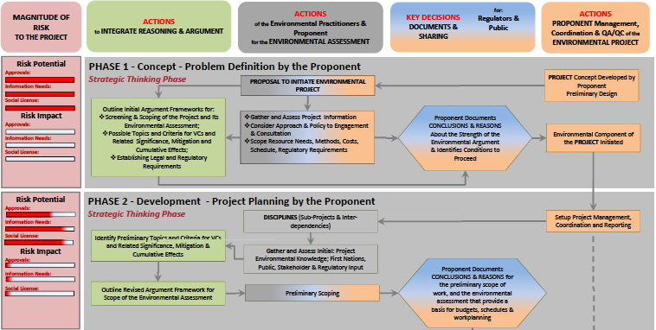
A Flowchart to Link OR to IA

Slide 13
What Next?
Introductory Workshops now available
Short, medium and long term options for participants
Flowchart, book underway, could expand
Online Options
Community of Practice
Short Courses, Webinars, Meetings
Other workshops
Open for suggestions!!

Slide 14
Adding Organized Reasoning to the IA Process Lessons Learned So Far
Powerpoints from IAIA 2017
Video from Reykjavik 2017
Paper and poster from IAIA 2016
Downloadable at www.glennbrown.ca

Slide 15
The End

